Slide 1
Finals: Week 11
SWING
Presented by:
Jacelyn Caratao
Justine Peralta
Mike Caram
Garvy Capalac
Martin Monte
Laurenz Listangco

Slide 2

Swing
Swing dance is a lively style of social dancing in which a dancer often lifts, spins and flips his or her partner. Considered both hip and cool, swing dancing is a favorite among social dancers of all ages.

Slide 3


Swing Style
Swing dance is characterized by lots of swinging, flipping, and throwing of dancers. Because it is a non-progressive dance style because it is mostly performed in one spot, it is a popular dance for a crowded dance floor.

Slide 4
Swing Style
Swing is a quick, fast-paced dance. Couples hold hands as opposed to placing hands on the shoulders or around the waist, as ballroom dancers do.

Slide 5

Swing Dances
Lindy Hop: Perhaps the most popular swing dance, this dance originated in Harlem. It's roots is traced back to Charleston and other African American dance forms, as well too influence of jazz music.
East Coast Swing: a lively and energetic swiwng dance style, seen often on club or tavern dance floors, this dance was influenced by the Foxtrot.

Slide 6



HELLZAPOPPIN'
THE HARLEM CONGAROOS
Lindy Hop

Slide 7
ULTIMATE BALLROOM STUDIO
MEMPHIS
East Coast Swing

Slide 8

Swing Dances
West Coast Swing: A slotted dance in which the follower travels back and forth along a rectangle, or slot.
Jitterbug: An umbrella term generally referring to swing dancing.

Slide 9
J&J MEET ME IN ST. LOUIS
JOEL TORGESON & ARIEL PECK
West Coast Swing

Slide 10
LIVING IT UP
JERRY LEWIS & SHEREE NORTH
Jitterbug

Slide 11

Swing Dances
Jive: Jive is a fast-paced variation of the Jitterbug. Characterized by fast footwork, kicks and spins.
Boogie-woogie: This dance is usually danced to rock music or blues.
Carolina Shag: A dance performed to beach music.

Slide 12
FRED ASTAIRE CUP
PARIS,FRANCE
Jive

Slide 13
DANCIN' THE BOOGIE
MAÉVA & WILLIAM
Boogie Woogie

Slide 14
BRENNAR & AUTUMN
Carolina Shag

Slide 15

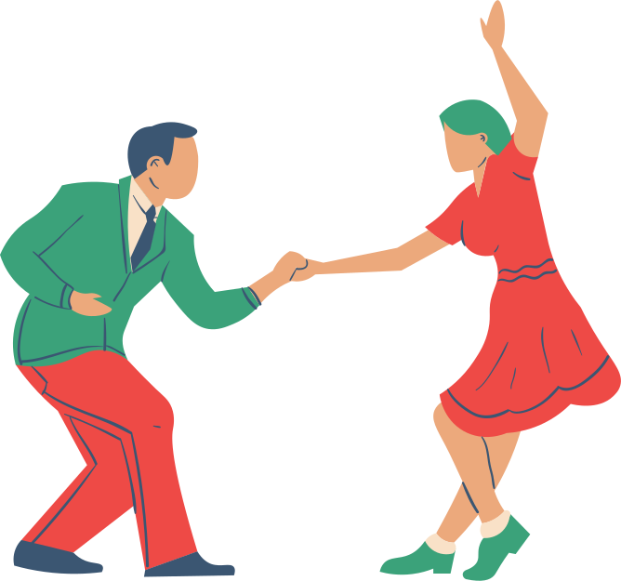
History of
Swing

Slide 16
The history of swing dance is a lively and rhythmic journey that mirrors the cultural and musical evolution of the 20th century. Swing dance emerged as a vibrant and exuberant dance form during the swing era, which spanned roughly from the 1920s to the 1940s. It evolved alongside the energetic music of the same name, characterized by its syncopated rhythms and big band orchestration.

Slide 17
1. Origins and Early Influences (Late 19th to Early 20th Century):
Swing dance has its roots in African American dance forms, including the Charleston and the Lindy Hop, which were danced to ragtime and early jazz music.
The Charleston, with its energetic and syncopated steps, gained popularity in the 1920s and laid the foundation for future swing dances.
2. The Birth of Lindy Hop (1920s):
The Lindy Hop, often referred to simply as the "Lindy," emerged in Harlem, New York City, during the late 1920s. It is named after Charles Lindbergh's transatlantic flight, which was a major cultural event at the time.
Lindy Hop combined elements of partner dancing, solo movement, and improvisation. It incorporated the Charleston's kicks and taps while introducing more complex partner interactions and dynamic movements.

Slide 18
3. The Swing Era (1930s-1940s):
The swing era, marked by the Great Depression and World War II, saw the rise of swing music and the swing dance craze.
Ballrooms and dance halls across the United States became hotspots for swing dancing to the tunes of iconic big bands, such as those led by Benny Goodman, Duke Ellington, and Count Basie.
Dances like the Jitterbug, Balboa, and Collegiate Shag also gained popularity during this period, contributing to the diverse array of swing dance styles.
4. Hollywood and Pop Culture (1930s-1940s):
Swing dance became a cultural phenomenon, largely due to its portrayal in Hollywood films and on stage.
Dancers like Frankie Manning and Norma Miller gained recognition for their innovative Lindy Hop routines and performances in movies, solidifying the Lindy's place in popular culture.

Slide 19
A DAY AT THE RACES
HOLLYWOOD
Whitey's Lindy Hoppers Incl. Norma Miller

Slide 20
SWING MUSIC
SWING MUSIC
Swing music is a style of jazz that developed in the United States during the late 1920s and early 1930s. It became nationally popular from the mid-1930s. The name derived from its emphasis on the off-beat, or nominally weaker beat
SWING MUSIC

Slide 21
3 Common
Steps of
Swing

Slide 22
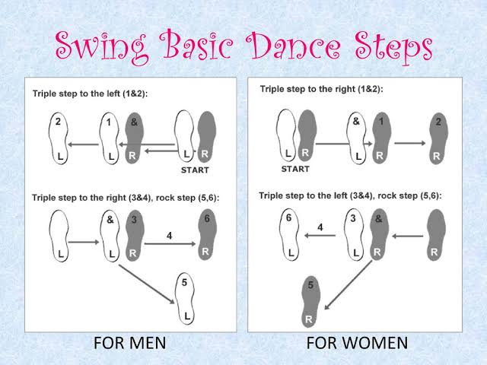
1. Basic Triple Step
· A basic step consisting of three quick steps:
step-step-triple step, which can be danced in various directions.

Slide 23
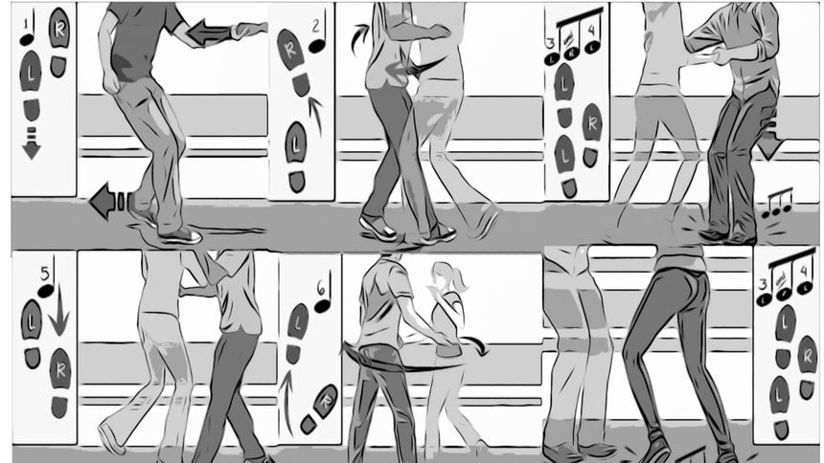
2. The Lindy Hop
It is a combination of two basic steps.
Basic Swing Out: The fundamental move where partners open up and come back together, often with an eight-count rhythm.
Lindy Circle: Partners rotate in a circular pattern while holding hands.

Slide 24
3. West Coast Swing
The main step for this dance move is the Sugar Rush.
Sugar Push: A key move where the leader leads the follower backward and forward, creating a stretch and compression connection.

Slide 25
SWING MUSIC
Example of Swing
IN
Music
SWING MUSIC

Slide 26
TAKE THE A TRAIN
Billy Strayhorn & Duke Ellington

Slide 27
SING, SING, SING
BENNY GOODMAN

Slide 28
JUMPING AT THE WOODSIDE
Count Basie and his Orchestra

Slide 29


FITNESS BENEFITS OF SWING DANCE
Cardiovascular Exercise: Swing dance involves continuous movement, including fast-paced steps and rhythmic patterns. This can elevate your heart rate and provide an effective cardiovascular workout, helping to improve heart health, lung capacity, and overall stamina.
Muscle Toning: Swing dance engages various muscle groups, particularly in the legs, core, and upper body. The quick footwork, lifts, and spins contribute to muscle toning and development.
Flexibility and Range of Motion: The dynamic movements and stretches in swing dance can help enhance flexibility and improve joint mobility, reducing the risk of injuries and promoting better overall movement.

Slide 30
FITNESS BENEFITS OF SWING DANCE
Coordination and Balance: Swing dance requires coordination between partners and the synchronization of various movements. Regular practice can improve your balance, body awareness, and spatial orientation.
Weight Management: Engaging in swing dance regularly can help you burn calories and manage your weight. The energetic nature of the dance can contribute to a calorie deficit when combined with a balanced diet.

Slide 31
DIETARY BENEFITS OF SWING DANCE
Energy Expenditure: Swing dance is a physically demanding activity, and the energy expended during dance sessions can create a greater need for fuel. Consuming a well-balanced diet with appropriate portions can support your energy levels and aid in post-dance recovery.
Nutrient Intake: A diet rich in nutrients, including vitamins, minerals, and antioxidants, can help support your body's overall function, including muscle repair and immune system health.

Slide 32
DIETARY BENEFITS OF SWING DANCE
Hydration: Proper hydration is crucial when engaging in any physical activity. Drinking an adequate amount of water before, during, and after dance sessions helps maintain your energy levels, prevent fatigue, and support recovery
Mental Well-being: Swing dance is not only a physical workout but also a form of creative expression and social interaction. Engaging in enjoyable activities like swing dance can contribute to reduced stress and improved mental well-being, indirectly affecting your dietary habits.

